Slide 1

Crowdfunding Analytics Project
Tools Used: Excel · SQL · Power BI · Tableau

Slide 2

Project Objective
To analyze global crowdfunding trends using data from Kickstarter to derive actionable insights on project performance, success rates, and funding patterns using Excel, SQL, Tableau, and Power BI.

Slide 3
Tools & Tech Stack
Excel – Data cleaning, EDA, USD conversion
SQL – Queries for KPIs
Power BI – Data modelling, Interactive dashboard with filters
Tableau – Advanced visualizations, time trend analysis

Slide 4
Data Preparation
Converted Epoch Time to Natural Time.
Created Calendar Table: Year, Month, Quarter, Financial Month & Quarter
Standardized currencies using static USD conversion rate
Built data model from multiple Excel sources

Slide 5
Key KPIs (Projects Overview)
Total Projects by Outcome
Projects by Category & Location
Project Launch Trends by Year, Quarter, Month

Slide 6
Successful Projects Analysis
Total Amount Raised
Total Backers
Average Duration (in Days) for successful campaigns

Slide 7
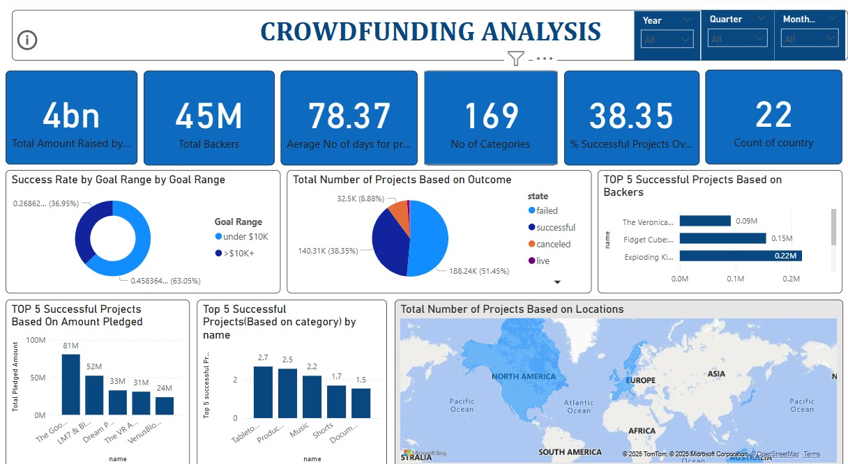
Dashboards Preview
Power BI dashboard

Slide 8
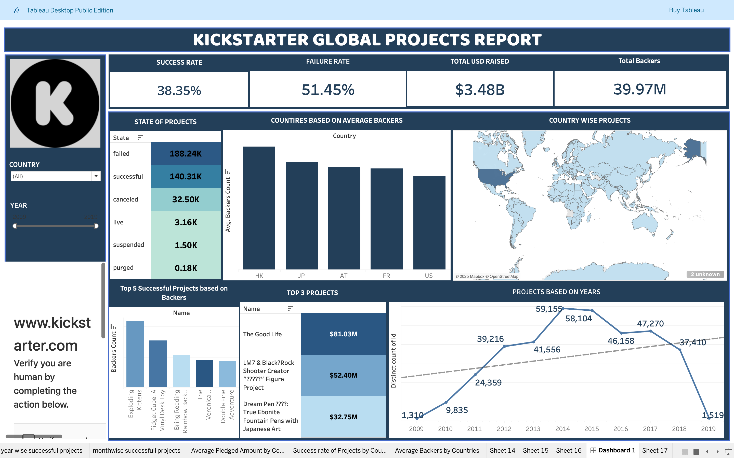
Tableau Dashboard

Slide 9
Key Insights & Learnings
Most projects failed due to low backer count or goal setting issues
Hong Kong & Japan had highest average backers/t.
Overall success rate: 38.35%, failure rate: 51.45%

Slide 10
Challenges Faced
Cleaning Epoch time and missing values
Aligning data across tools
Creating accurate time-based and financial calendar fields

Slide 11
Conclusion & Takeaways
Gained practical hands-on experience in BI tools
Understood end-to-end project lifecycle: raw data to business insight
Built a portfolio-ready project demonstrating technical and analytical skills

Slide 12

Thank You
Any questions?

